Slide 1
Data Visualization and Analytics
Using d3

Slide 2
Brief Introduction
The task of visualization of twitter data was completed and the code has been uploaded to Github.
LocalHttp server can be setup with the help of Python and the pages can be accessed.
One of the instance of the visualization : Bubble chart has been integrated in the website and is up and running.

Slide 3
What is D3?
Data-Driven Documents
D3.js is a JavaScript library for manipulating documents based on data. D3 helps you bring data to life using HTML, SVG, and CSS. D3’s emphasis on web standards gives you the full capabilities of modern browsers without tying yourself to a proprietary framework, combining powerful visualization components and a data-driven approach to DOM manipulation.

Slide 4
Workflow
Discussed various visualizations
Learnt D3
Experimented with some visualizations
Created Generic codes
Deployment on the server

Slide 5
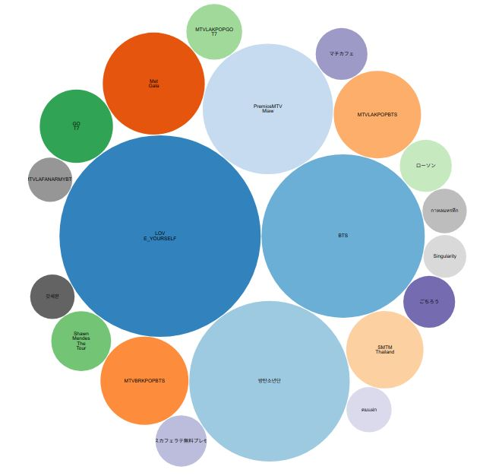
Bubble chart
A nice way of displaying weighted features

Slide 6
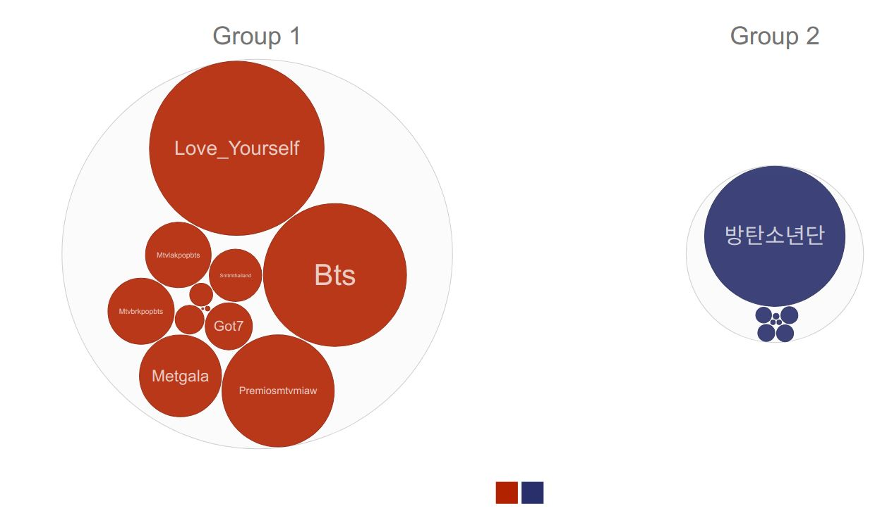
Bubble chart
Data can also be segregated and compared

Slide 7
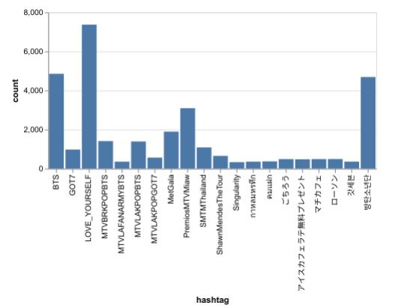
Bar charts
Simple bar charts with interactive information can be helpful

Slide 8
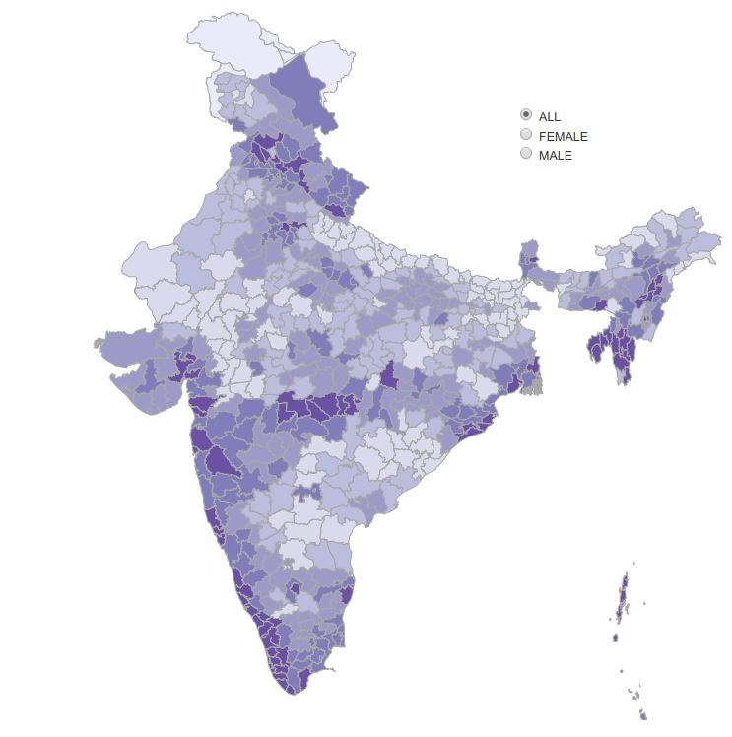
Chloropleth
Chloropleth representation can be helpful in geographic data representation

Slide 9
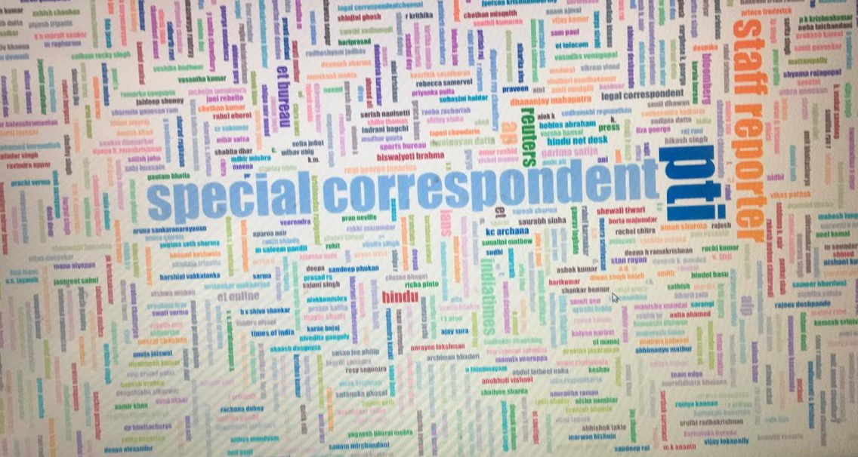
WordClouds
Wordcloud like this could help in literal and segmented representation of data

Slide 10
Work is uploaded on Github privately.
https://github.com/akshat-khare/datavisproject

Slide 11

Result
D3 was explored, learnt and applied

Slide 12

Thanks!
Akshat Khare
https://github.com/akshat-khare/datavisproject

